Slide 1
Considering
Home Ownership

Slide 2
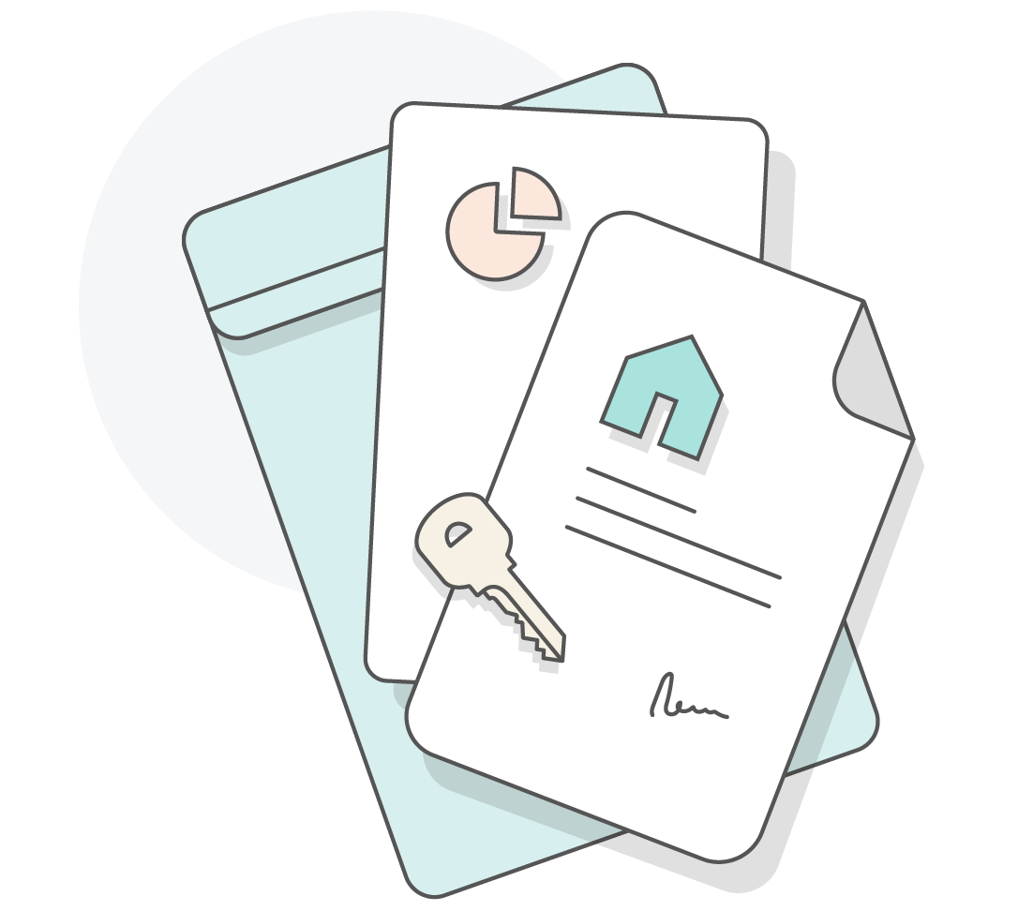
Workshop
Goals
In this workshop, you will...
Review the costs and responsibilities associated with home ownership.
Explore the loan and repayment process.
Learn how to find out if you are financially ready to own a home.

Slide 3
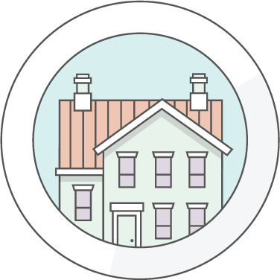
Pro or Con?
A home has long-term value.
You need to make payments toward a home.
You need to pay taxes on a home.
You can remodel your home any way you like.

Slide 4
The Pros and Cons of Owning a Home
A home has long-term value.
Pro: The value of the home may go up over time.
Con: The value of the home may go down over time.
You need to make payments toward a home.
Pro: A portion of every monthly payment goes to the principal and gets you closer to owning a valuable asset.
Con: You need to make a large down payment up front, and there may be many other home ownership costs.
You need to pay taxes on a home.
Pro: Home owners may be able to deduct mortgage interest and property taxes on their income tax return.
Con: You must pay property taxes.
You can remodel your home any way you like.
Pro: You can renovate and decorate your home.
Con: You are responsible for all repair and maintenance costs.

Slide 5
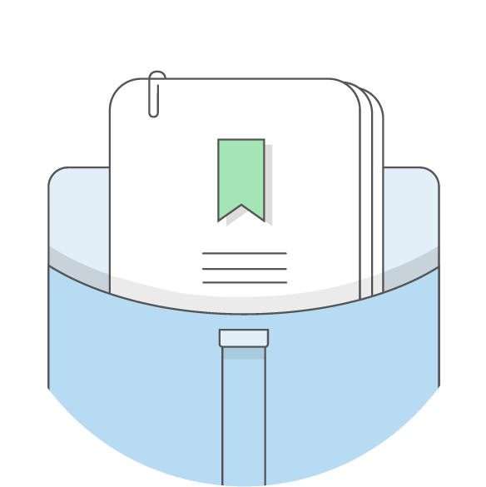
Common Terms
Income: Money earned from wages (salary, tips, etc.), Social Security, or investments
Income history: Proof of employment; lenders often require at least two years of income history
Debt-to-income ratio: A percentage that measures how much of a person’s monthly income goes toward debt payments
Credit score: A three-digit numerical score that predicts a person’s ability to repay loans
Down payment: A lump sum of cash used to pay for part of your home that shows lenders you’re committed to the purchase

Slide 6
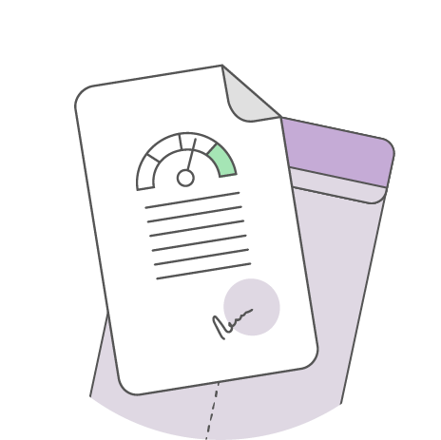
The Five Cs of Credit
Capacity: Your present and future ability to meet your payment obligations
Capital: Your assets, including cash and savings plus any large purchases that have a lot of value, such as investments, property, etc., that you could sell quickly for cash
Collateral: Property or assets offered to secure a loan
Character: Your history of delivering on commitments
Conditions: The purpose of the loan and any factors that might affect your ability to repay

Slide 7
Financial Action Plan: Spending
Christina is a divorced mother of one. Her son, Theodore, is 10 years old. She has a full-time job, but she also works part time on the weekend. She created a spending action plan so she can see what her current expenses are and what she regularly spends money on.
Needs |  |  | Wants
Rent Payment | $300 |  | Fast Food | $20
Credit Card Payment | $1,000 |  | Movies | $20
Auto Insurance | $100 |  | Cable TV | $120
Other | $30 |  | Data Plan for Cell Phone | $200
Household Expenses | $35
Student Loan | $0
Court-Ordered Payment (Alimony, Child Support, etc.) | $0
Food/Groceries | $150
Transportation | $100
Clothing | $40
Total Expenses | $1,755 |  | Total Expenses | $360

Slide 8
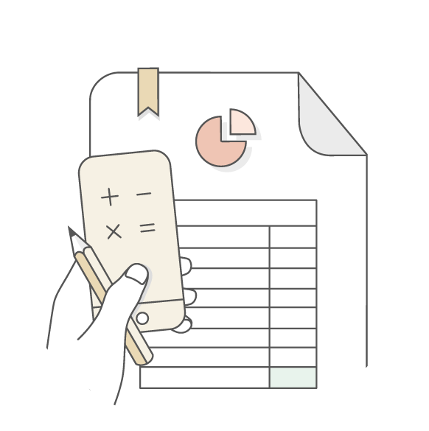
The Debt-to-Income Ratio
Marta’s Monthly Expenses:
Student loan payment | $600
Car payment | $400
Payment toward credit card debt | $700
Total | -----
Marta’s Monthly Income: $4,000
DTI = Total Monthly Expenses / Total Monthly Income

Slide 9
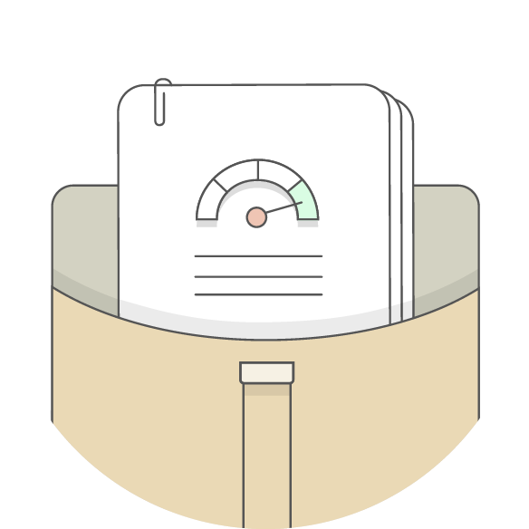
Credit Score
What affects my credit score?
Payment history
Amounts owed
Length of credit history
Types of credit used
New credit
A credit score is a three-digit number that reflects a person’s credit history and predicts for lenders the person’s likelihood to repay a loan. The higher the number, the better the score.
How do I check my credit score?
For a fee, you can get your credit score at https://www.myfico.com.
What determines my credit score?
Data on your credit report, which is created by credit bureaus, such as:
Equifax
Experian
TransUnion

Slide 10
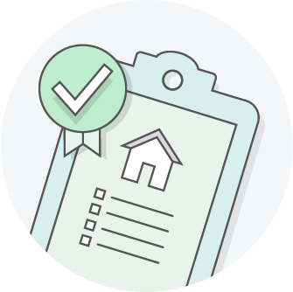
Home-Buying Costs
Down Payment
Miscellaneous Costs
Closing Costs

Slide 11
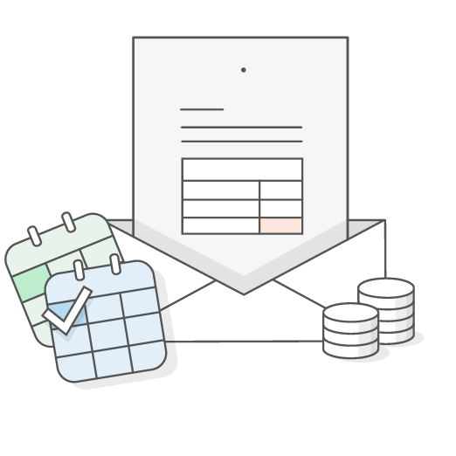
Home-Buying Costs: Down Payment
A down payment is an initial cash payment toward the purchase of a home. It typically ranges between 3% and 20% of the purchase price.
Marta wants to buy a house that costs $80,000. See how having a down payment can affect her interest rate and other costs.
Scenario A:
Scenario B:
Marta does not have any cash saved for a down payment, so she will need to borrow the full amount.
Down payment: $0
Interest rate: 5%
At the end of the first year, she will have paid $3,900 in interest.
Marta has saved $20,000 for a down payment. She needs to borrow only $60,000 from the bank.
Down payment: $20,000
Interest rate: 4.5%
At the end of the first year, she will have paid $2,700 in interest.

Slide 12
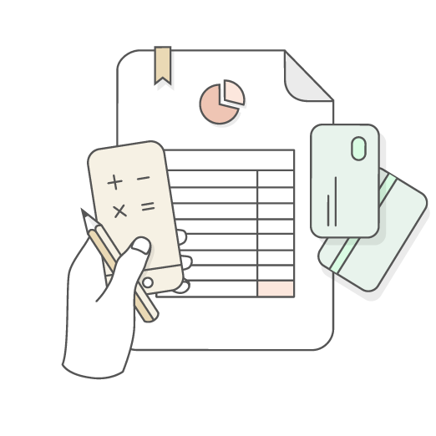
Home-Buying Costs: Miscellaneous Costs
Credit check
Earnest money
Inspection costs
Repair costs
Appraisal costs
Ongoing costs

Slide 13
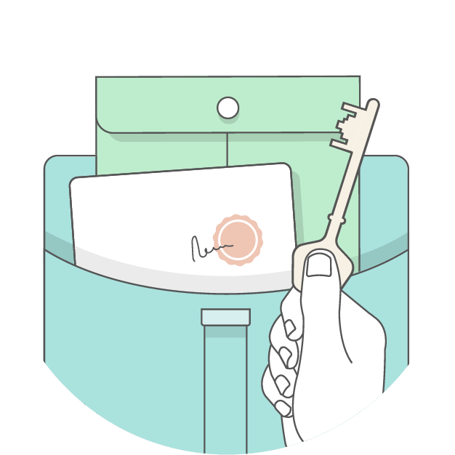
Home-Buying Costs: Closing Costs
Closing costs are expenses over and above the purchase price of a home. Common closing costs include—but are not limited to—the following:
Appraisal fees
Tax service provider fees
Title insurance
Government taxes
Prepaid expenses, such as property taxes, homeowner’s insurance (if applicable), and interest until your first payment is due
Total amount of closing costs may be between 2% and 5% of the purchase price.

Slide 14
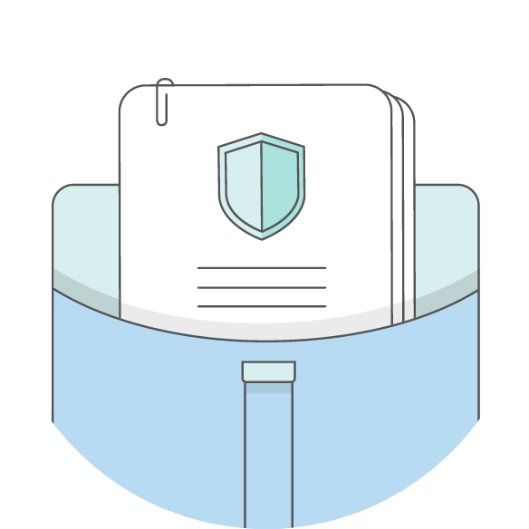
Private Mortgage Insurance
What is it?
Insurance that guarantees the lender will be paid the amount of the remaining mortgage if the buyer defaults
Who needs it?
Anyone who can’t make a down payment equal to at least 20% of the purchase price

Slide 15
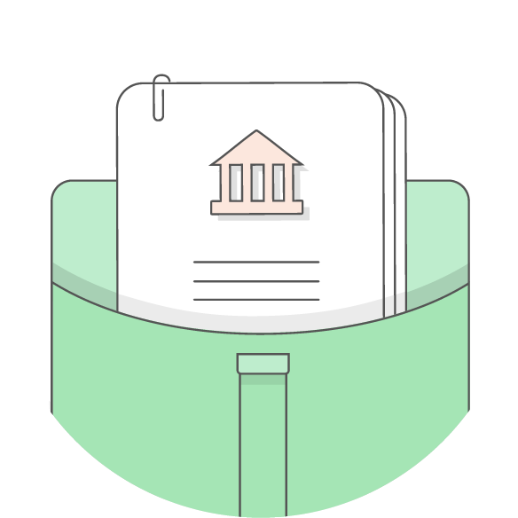
Types of Loans
Conventional loans are mortgage loans provided to people who meet certain criteria, including income level, DTI percentage, and credit score. These loans are provided by the following organizations:
Financial institutions
Credit unions
Mortgage companies
Fannie Mae
Freddie Mac
Nonconventional loans are government loans available to buyers who may not have good credit or a large enough down payment. These loans are provided by the following organizations:
Federal Housing Administration (FHA): The FHA can help insure your loan so you’re able to get a better deal through a private lender (such as a bank or mortgage company).
Veterans Administration (VA): For eligible veterans, service members, and surviving spouses, the VA can guarantee a portion of a loan from a private lender.
USDA Rural Development Services: For those looking to buy a home in a rural area, the USDA offers several types of loan assistance for direct loans and guaranteed loan programs. USDA assistance programs typically are targeted to low- and moderate-income individuals.

Slide 16
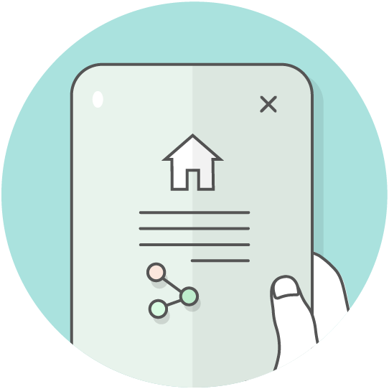
Free Resources
The Truth in Lending Act requires that buyers be given
information about the key features, costs, and risks of their
mortgages (including Loan Estimates and Closing Disclosures).
The Consumer Financial Protection Bureau (www.consumerfinance.gov/owning-a-home/) provides protections
and resources for buyers when financing a home.
The U.S. Department of Housing and Urban Development website (https://www.hud.gov/topics/buying_a_home)
has many helpful resources, including the following:
  Fair Housing: Equal Opportunity for All
  Information about borrowers’ rights
  Home-buying programs
The USA.gov Finding a Home site can be found at
https://www.usa.gov/finding-home.

Slide 17

Summary
Remember...
It is important to understand your personal financial readiness before considering home ownership.
Be sure to understand your personal credit and your debt to income ratio when considering home ownership.
You must thoroughly review all the associated costs with home ownership before beginning the process of purchasing a home.

